Slide 1
Scholarships 101

Slide 2
Scholarships
Scholarships are free money students use to help pay college expenses.
Scholarships are available to students of all ages.
High school students should apply for 2-3 scholarships every week.

Slide 3
Get Organized
Plan and prepare for scholarships early.
The busiest time for scholarship deadlines is Feb. 1 – April 30.
Don’t rush when completing applications. Be thorough!
Residency

Slide 4
Search For Scholarships
Don’t pay for online scholarship websites
Investigate your source to make sure it’s legit
Search college websites
Use Google to find scholarships
Local scholarships have fewer applicants

Slide 5
Scholarships Are Based On
Sports
Community Service
Grades
Hobbies
Test Scores

Slide 6
Scholarships Are Based On
Financial Need
Residency
Skills
Need
Essay
Leadership
College Major

Slide 7
Search For Scholarships
CollegeXpress.com
SallieMae.com
Study.com
Unigo.com
GoingMerry.com
ScholarshipOwl.com
Bold.org
MyScholly.com
CareerOneStop.org
UCanGo2.org
OKcollegestart.org
OCCF.org
FastWeb.com
Scholarships.com
Scholarships360.org
BigFuture.collegeboard.org
Cappex.com
College-Scholarships.com
Petersons.com
StudentScholarshipSearch.com

Slide 8
Don’t Rush
Read all
instructions carefully
Answer each question completely
Write a great essay
Review with your teacher, parent or friend
Ask for recommendation letters early
Proofread!
Proofread!
Proofread!

Slide 9
Writing Essays
A good scholarship essay …
Captivates readers
Is original
Has a main point
Makes you dazzle
Is honest
Sets you apart
Has no grammatical or spelling errors

Slide 10
Recommendation letters are needed for many scholarships. Evaluate these tips when making your request.
Determine who to ask
Analyze your need for letters
Keep it safe
Evaluate your letter
Request letters early

Slide 11
Watch Deadlines
Many scholarships have early deadline dates
Keep track of requirements for each scholarship
Don’t wait until the last minute
Apply early

Slide 12
Don’t Forget
Apply for scholarships every year
Complete your FAFSA annually at FAFSA.gov
Write a great essay you can
use for multiple applications
Send all required documents with your scholarship application
Don’t miss your scholarship deadline

Slide 13
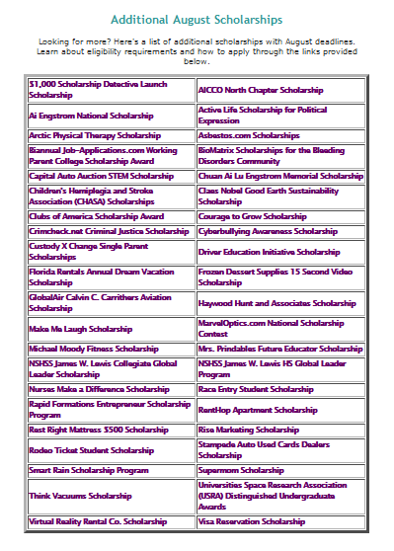
UCanGo2.org

Slide 14
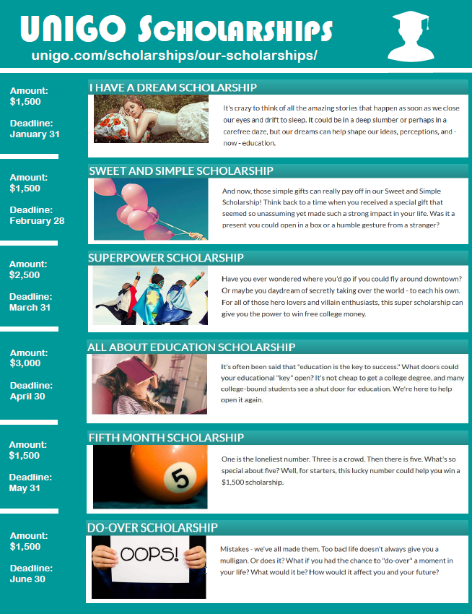
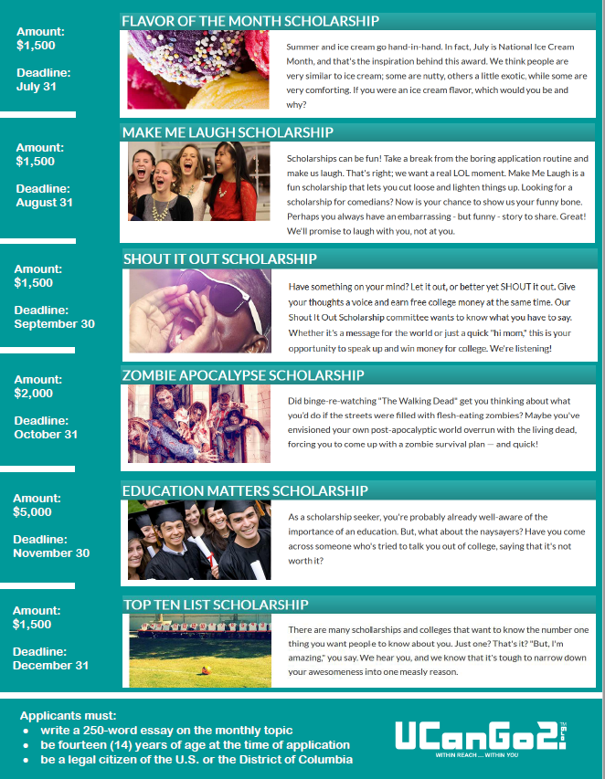
Unique Scholarships
Applicants must:
Write a 250 word essay on the monthly topic
Be 14 years of age, or older, at the time of application
Be a legal citizen of the U.S. or D.C.

Slide 15
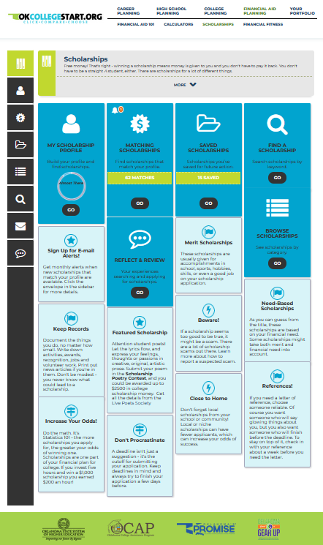
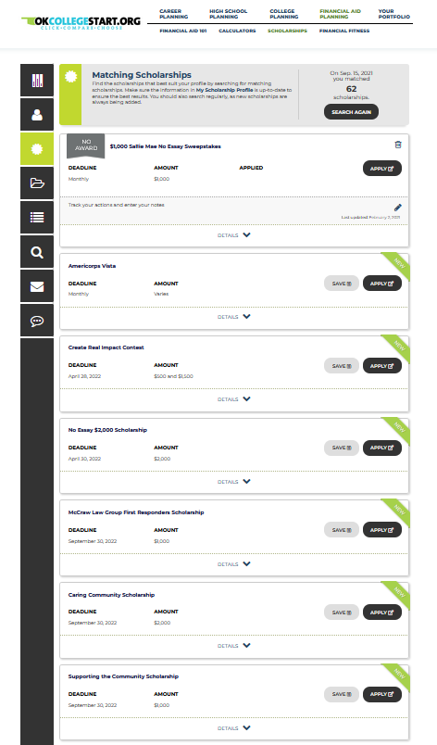
OKcollegestart.org

Slide 16
Contact Us
405.234.4239
866.443.7420 (toll free)
UCanGo2@ocap.org
This presentation is for educational purposes only, and is not intended to be construed as financial, investment, legal and/or tax advice.

